Slide 1
Employee Data Analysis using Excel
STUDENT NAME: KARTHICA .E
REGISTER NO : 312209837
NM ID : 9DBCCCCF633C5FCAFF646BEEF9E084AC
DEPARTMENT : B.COM ( Accounting And Finance)
COLLEGE : Valliammal College For Women

Slide 2
PROJECT TITLE
Employee salary Analysis using Excel

Slide 3


AGENDA
Problem Statement
Project Overview
End Users
Our Solution and Proposition
Dataset Description
Modelling Approach
Results and Discussion
Conclusion
3/21/2024 Annual Review

Slide 4

PROBLEM STATEMENT
Analyze employee salary data to identify trends and insights Deliverables Salary summary table , Departmental and job title reports - Visualizations ,Salary adjustment recommendation.
Key metrics: average salary, salary range, top earners, underpaid employees- Excel tools: pivot tables, conditional formatting, charts, formulas, data analysis tools.

Slide 5

PROJECT OVERVIEW
Employee Salary analysis:
1.Employee Salary Insights.
2. Salary Analysis Dashboard.
3.Employee Compensation Review.
4. Salary Trends and Insights.
5. Employee Salary Analysis Report.
Analyze employee salary data to identify trends and insights

Slide 6


WHO ARE THE END USERS?
The End users are the employee of the company HR Manager, Finance Manager, Department Heads, Compensation Analyst, Business Leaders, Recruiters, Employee Relations Specialists.

Slide 7

OUR SOLUTION AND ITS VALUE PROPOSITION
Unlock data-driven salary decisions with Empower Salary Insights, your comprehensive Excel solution. Optimize salary budgets, ensure equity and competitiveness, and inform talent management strategies to drive business success and empower your workforce.

Slide 8
Dataset Description
Employment Data Set – Kaggle
9 – Features
5 – Features
Employee ID – Text
Name – Text
Gender – Male/Female
Salary – Number
Employee Type - Text

Slide 9

THE "WOW" IN OUR SOLUTION
To Fill Up The Blank Cell
Identify the blank cell using conditional formatting.
remove of blank cell by using sort and filter
3/21/2024 Annual Review
9

Slide 10
MODELLING
DATASET : Employment Dataset
FEATURE SELECTION :
Employee ID , Name , Gender , salary , Employee Type.
DATA CLEANING :
Salary Summary – Pivot Table
Department – Rows
Gender – Column
GRAPH – BAR FOR EMPOLYEES SALARY
10

Slide 11
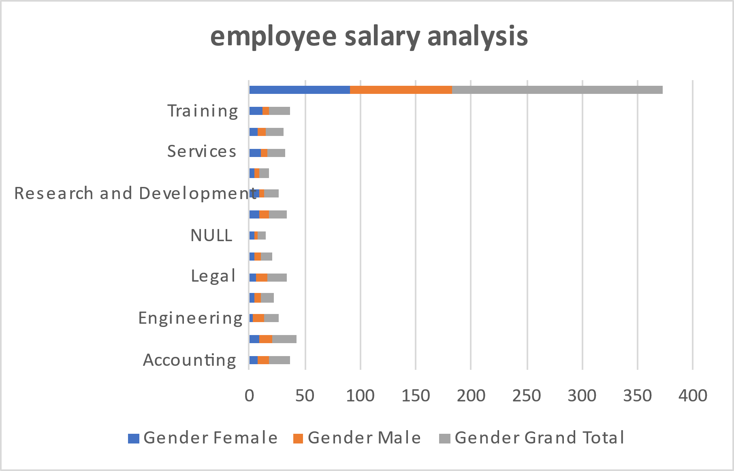
RESULTS
11

Slide 12
conclusion
Employee Salary Analysis conclusion:
Identified areas For Improvement, Recommended Adjustments to Salary Structures , And Outlined Next Steps to Ensure Fair And Competitive Compensation ,
Driving Business Outcomes And Employee Engagement.

